Slide 1
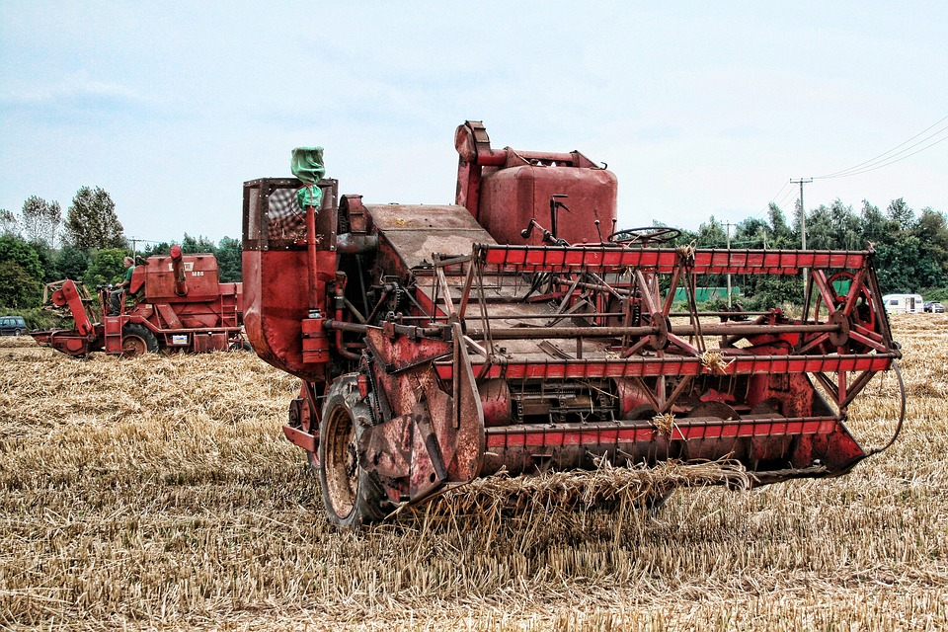

Big, Red
Combine Harvester
Click to play:

