Slide 1


Hillshott School Nursery
Parent Information
Phonics & Reading

Slide 2
What is Phonics?
Phonics is a method of teaching children to read and then write. In school we use a programme called ‘Little Wandle.’
We have a 20 minute phonic session in Reception every day
Each session begins by ‘revisting’ previously learnt sounds and words.
We then ‘teach’ a new sound. On Friday’s we revisit the sounds learnt that week.
This is followed by a blending activity to ‘practise’ using this new sound for reading.
Finally we ‘apply’ these new skills to read or write a simple a sentence.

Slide 3
Terminology
Phoneme - The smallest unit of sound that can be identified in words. We sometimes simply call this a ‘sound’, although it is helpful for children to use the term ‘phoneme’
Grapheme - A letter or group of letters used to represent a particular phoneme when writing.
Digraph - A grapheme using two letters to represent one phoneme. With children, we frequently reinforce it with the mantra ‘two letters, one sound’.
Trigraph - A grapheme using three letters to represent one phoneme. With children, we frequently reinforce it with the mantra ‘three letters, one sound’.
Segment - To identify each of the individual phonemes in a word, working all the way through from left to right. This is an important first stage of writing (spelling) a word but needs to be practised orally first. Counting the phonemes is often helpful in reinforcing this process.
Blend - To combine individual phonemes into a whole word, working all the way through from left to right. Once the GPCs involved have been learned, blending is the key process involved in reading words effectively. It is a skill that needs extensive practice.

Slide 4
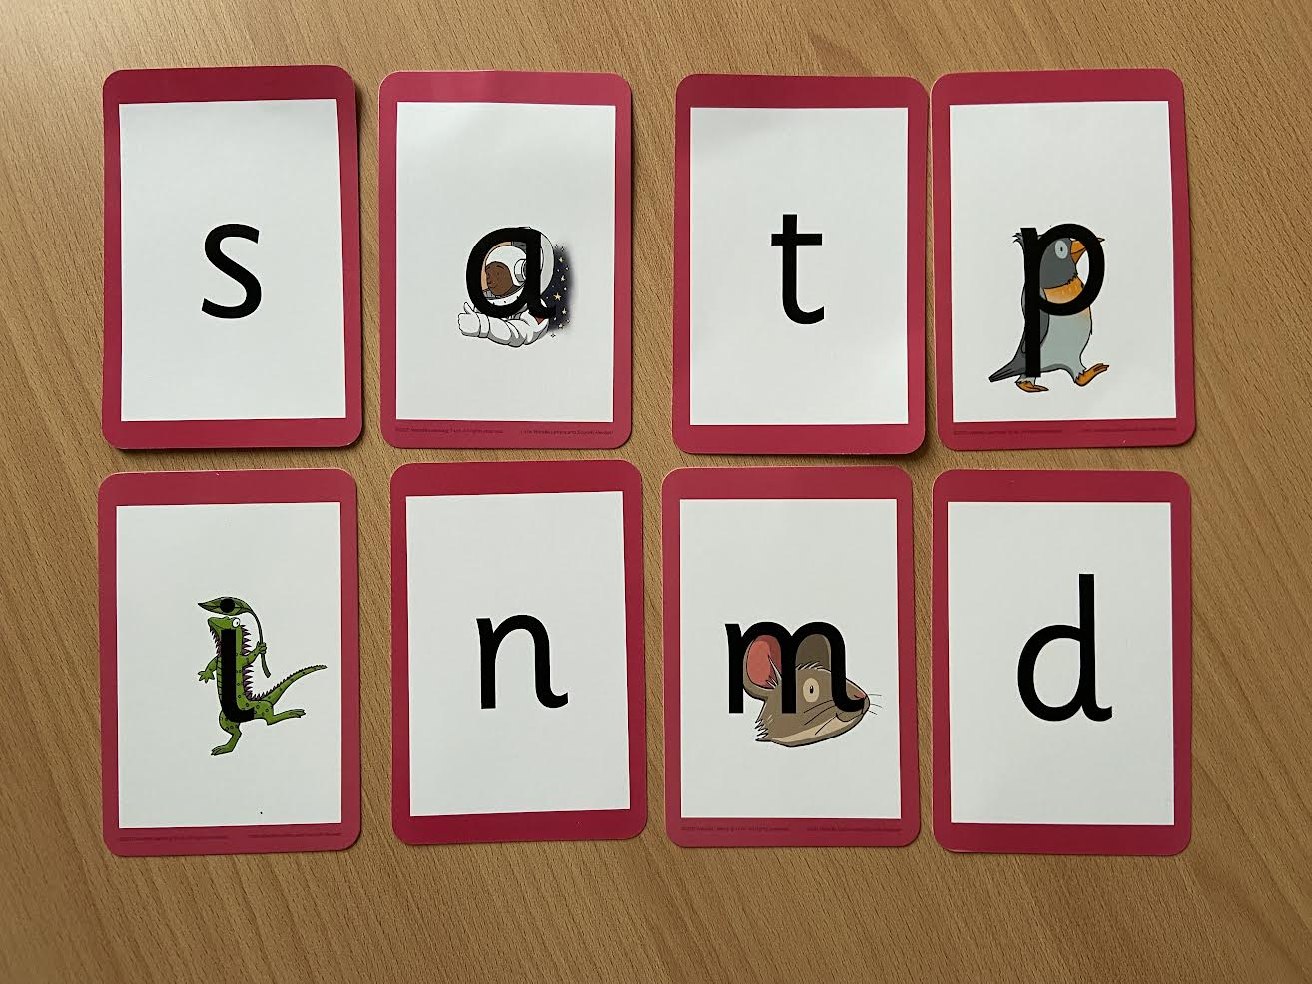
Little Wandle Resources

Slide 5
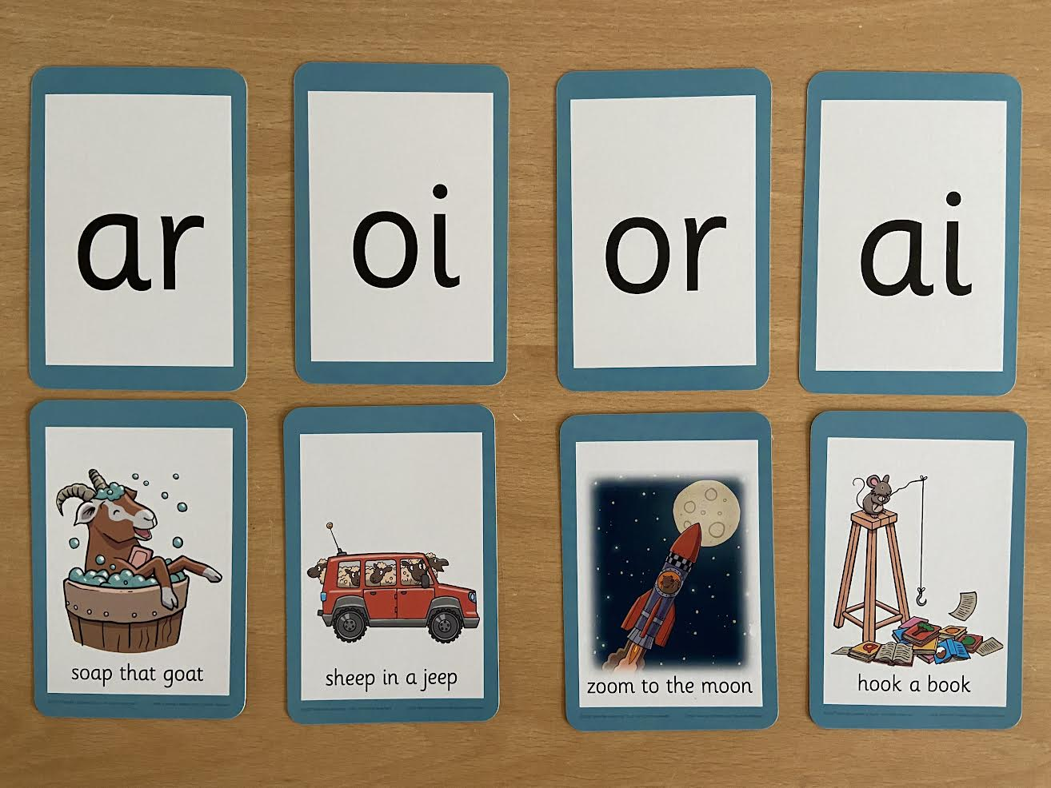
Little Wandle Resources

Slide 6
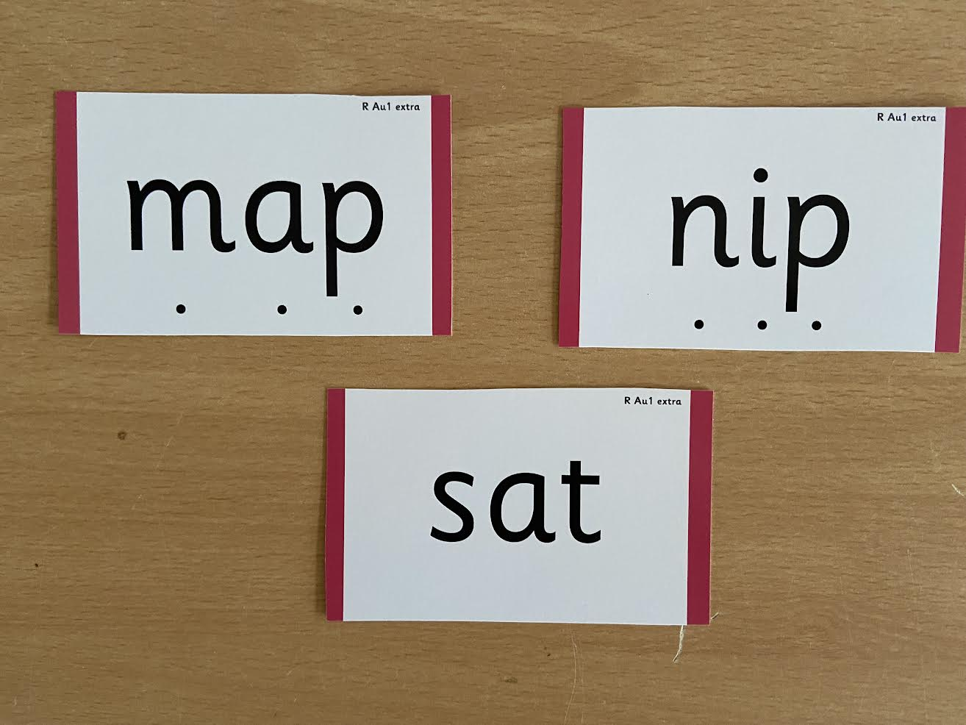
Little Wandle Resources

Slide 7
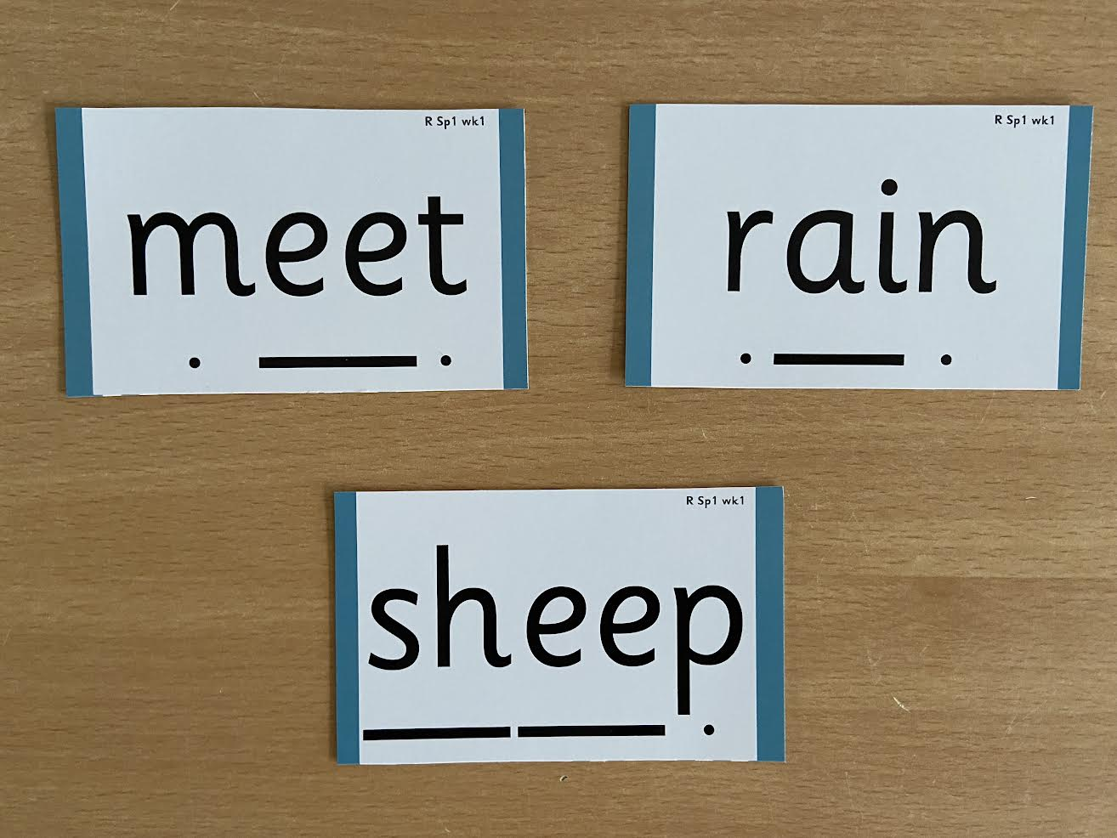
Little Wandle Resources

Slide 8
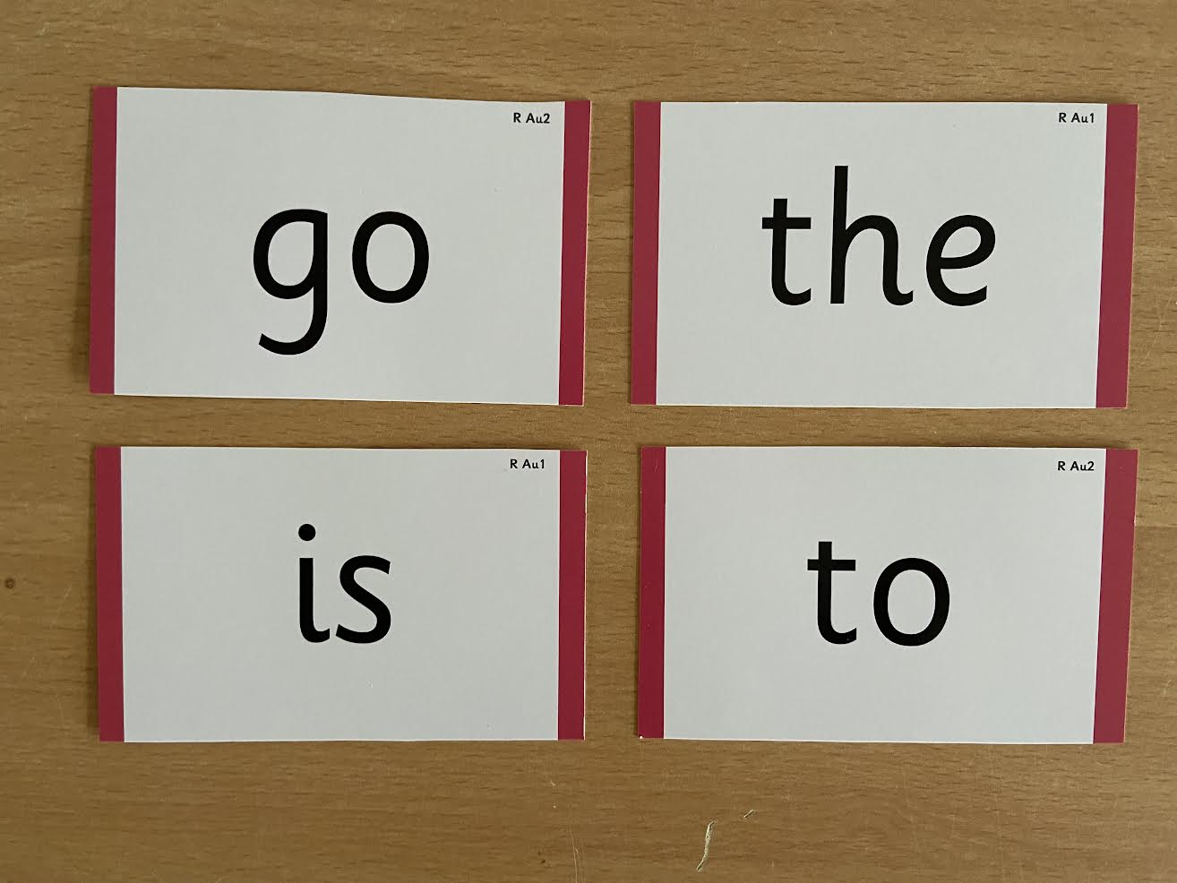
Little Wandle Resources

Slide 9
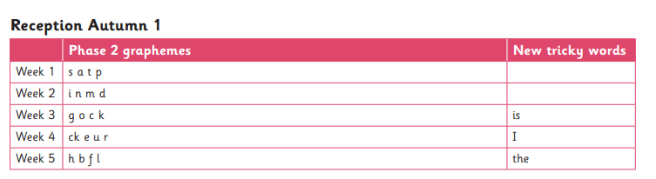
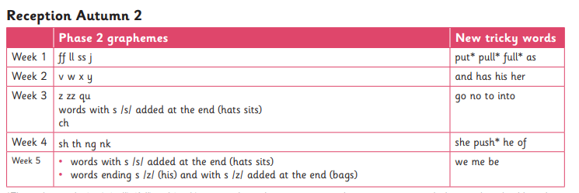
Teaching Sequence

Slide 10
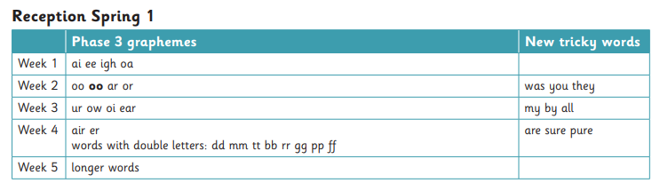
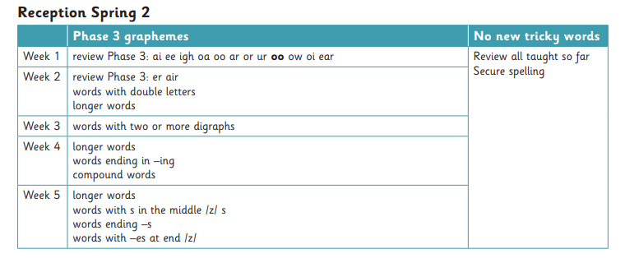
Teaching Sequence

Slide 11
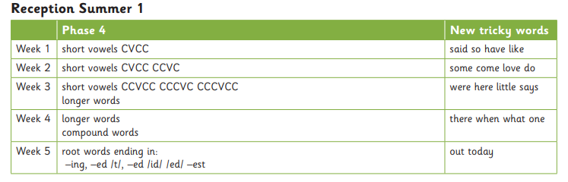
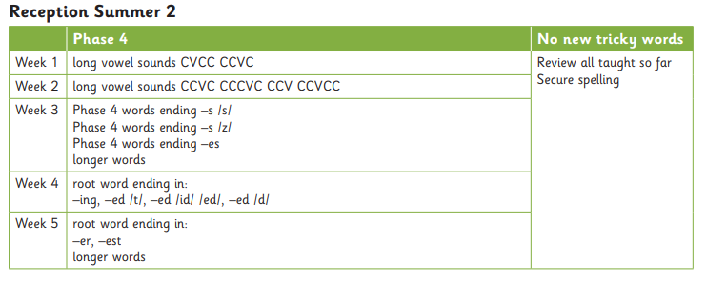
Teaching Sequence

Slide 12
Reading
Once children have a secure knowledge of a number of GPC’s (Grapheme Phoneme Correspondences) and are confidently blending, they will be ready for reading books.
Prior to this they may have wordless books which develop great language skills and teach children the layout of books and how to handle books.
Please make sure books are in book bags everyday.
Please look after our books by not putting water bottles in bags.

Slide 13
Learning to Read
Children read carefully matched decodable books to support the development of fluently and independence.
Decoding
Prosody (intonation, expression)
3. Comprehension
When children take their book home to read they should be 95% fluent
Please do not worry that a book is too easy – your child needs to develop
fluency and confidence in reading. Re-reading a book they have had before helps develop fluency – this is the goal.
Celebrate their success!!!

Slide 14
What you can do at home
Please look at the Little Wandle videos and guidance for parents
https://www.littlewandlelettersandsounds.org.uk/resources/for-parents/
Support children in learning the correct pronunciation of phonemes.
Let your child “show off” their reading to you and celebrate and praise all the way!
Share books with your children for pleasure

