Slide 1
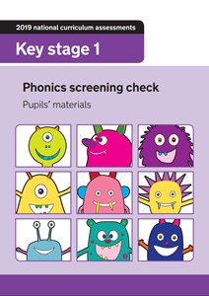
Year One
Phonics Screening Check
A Guide for Parents

Slide 2

What is the Phonics Screening Check?
Children in Year 1 throughout the country will all be taking part in a phonics screening check during the same week in June (wc 9th June). Children in Year 2 will also take the check if they did not achieve the required result when in Year 1 or they have not taken the test before.
The phonics screening check is designed to confirm whether individual children have learnt phonic decoding and blending skills to an appropriate standard.

Slide 3
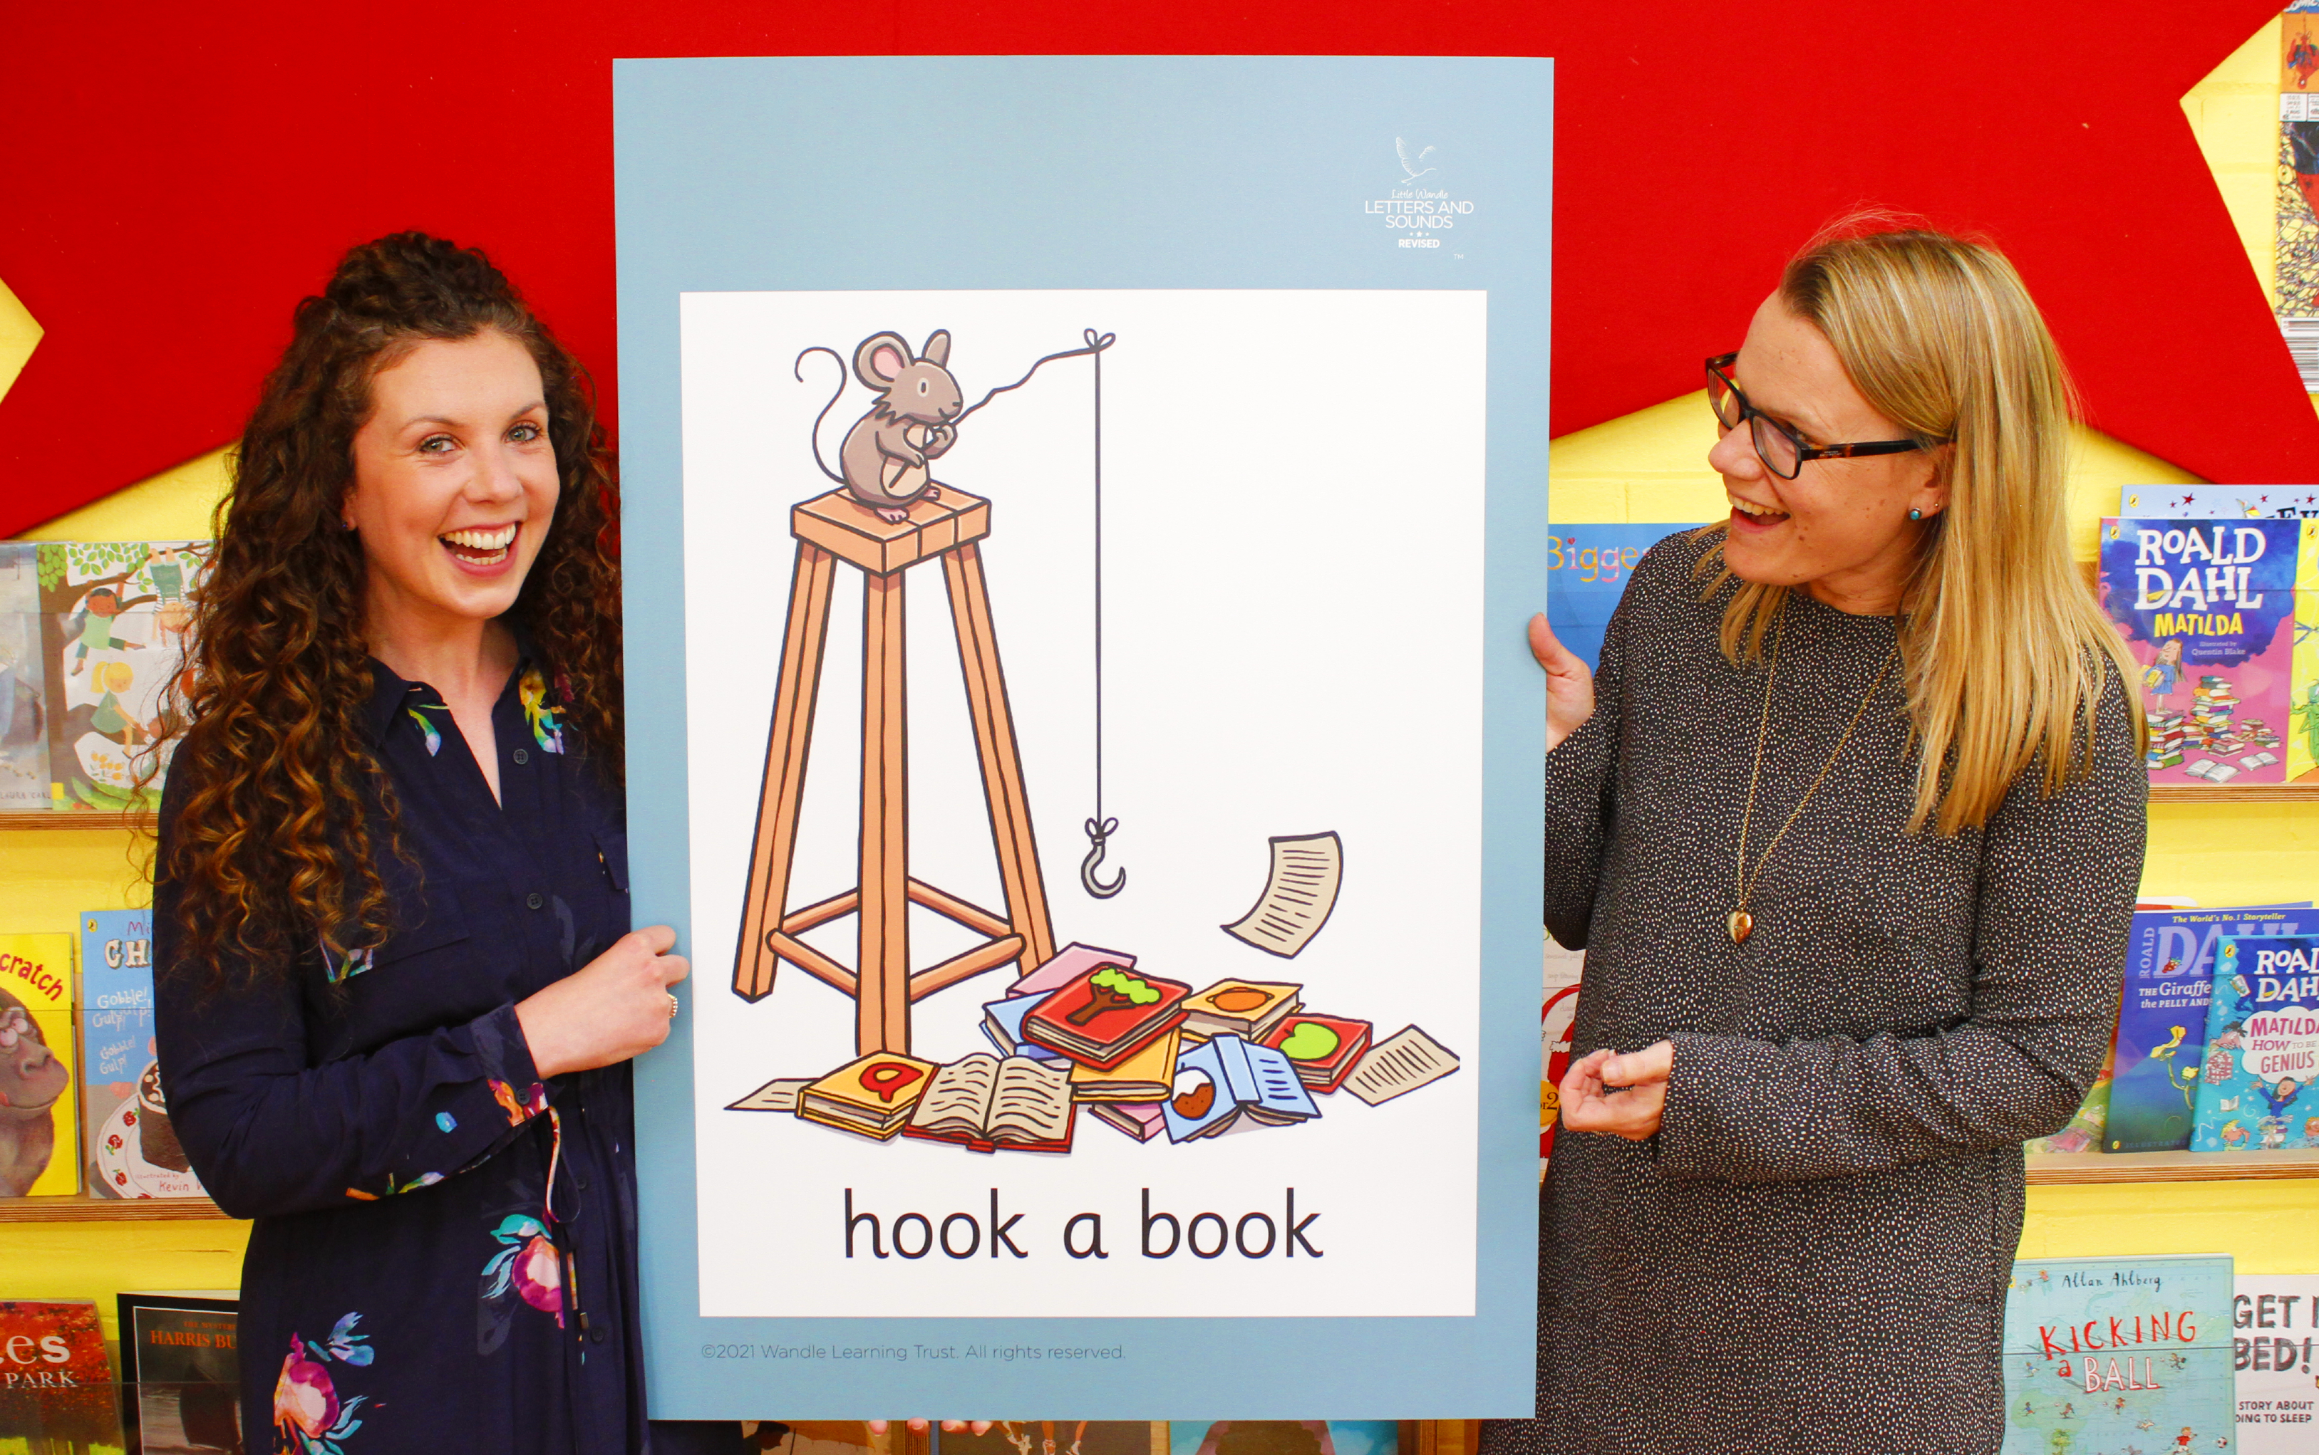
Little Wandle Letters and Sounds Revised
Our school has chosen
Little Wandle Letters and Sounds Revised as our systematic, synthetic phonics (SSP) programme to teach early reading and spelling.

Slide 4
Phonics is:
“making connections between the sounds of our spoken words and the letters that are used to write them down.”
Notes:
It sounds complicated but it really isn’t!

Slide 5
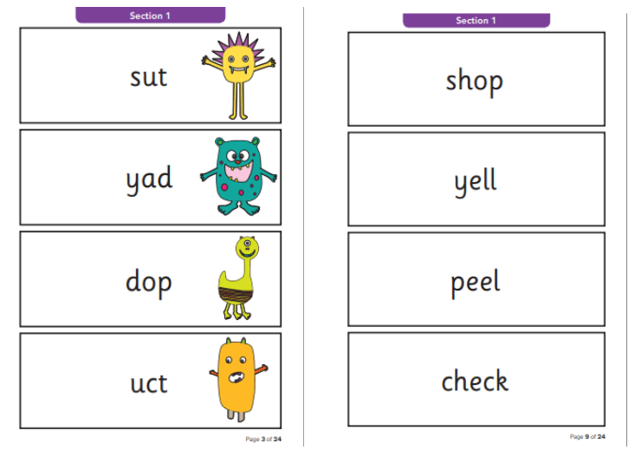
What Happens During the Test?
The test contains 40 words. Each child will sit 1:1 and read each word aloud to their teacher. The test will take approximately 10 minutes per child, although all children are different and will complete the check at their own pace. The list of words the children read is a combination of 20 real words and 20 alien words (nonsense words).

Slide 6
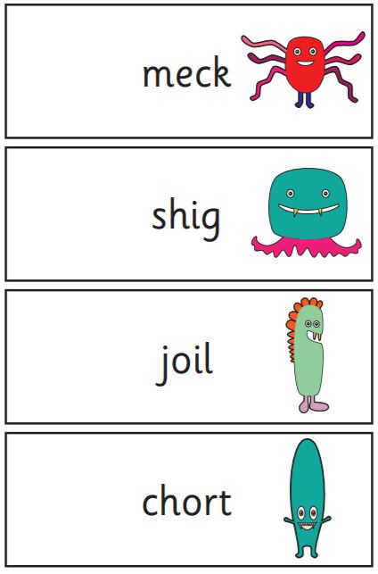
Alien Words (Nonsense Words)
The alien or nonsense words will be shown to your child with a picture of an alien. This provides the children with a context for the word which is independent from any existing vocabulary they may have. Alien words are included because they will be new to all pupils; they do not favour children with a good vocabulary knowledge or visual memory of words.

Slide 7

Reporting to Parents
By the end of the summer term all schools must report each child's results to their parents. They will also confirm if the child has met the standard threshold. Children who do not achieve the expected level will retake the test when they are in Year 2.

Slide 8

How Are the Results Used?
Results from the check will be used by schools to analyse their own performance and for Ofsted to use in inspections.

Slide 9
How Can I Help My Child at Home?
Play lots of sound and listening games with your child.
Read as much as possible to and with your child.
Encourage and praise – get them to have a ‘good guess’.
If your child is struggling to decode a word, help them by encouraging them to say each sound in the word from left to right.
Blend the sounds by pointing to each one, e.g. /c/ in cat, /p/ in pat, /ng/ in sing, /ee/ in been. Next move your finger under the whole word as you say it.
Discuss the meaning of words if your child does not know what they have read.

Slide 10
Any questions?
Link to past papers: https://www.gov.uk/government/collections/national-curriculum-assessments-past-test-materials

